Slide 1
MDS 6212: AQUMON Robo-Advisors
invest-it-and-forget-it investment journey

Slide 2
Background
Background for aqumon

Slide 3
Background
Background Info for aqumon’s robo-Advisors

Slide 4
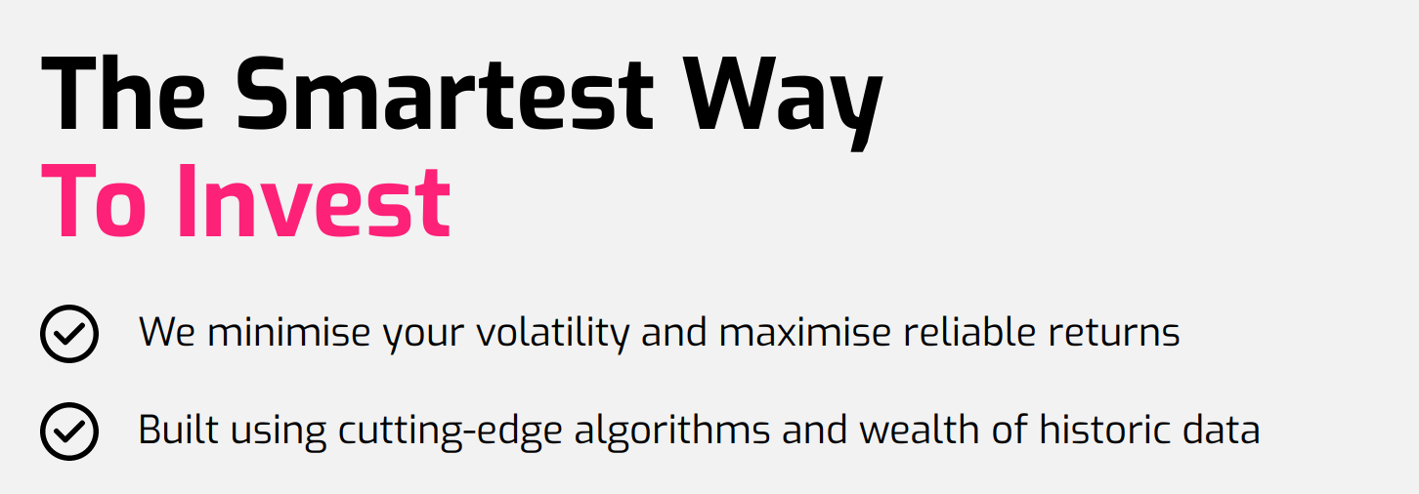

Slide 5
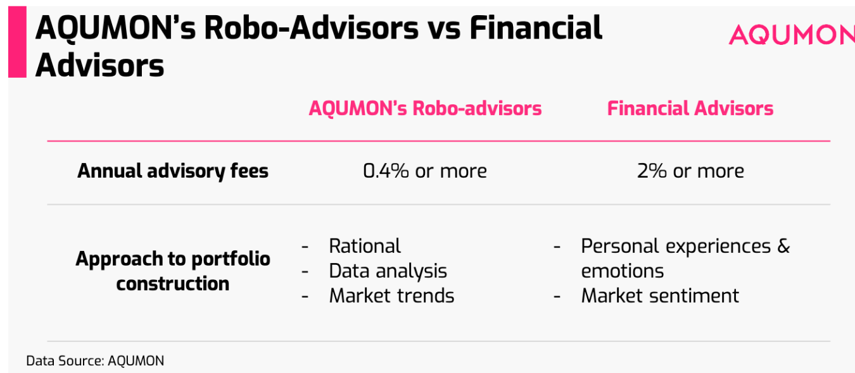

Slide 6
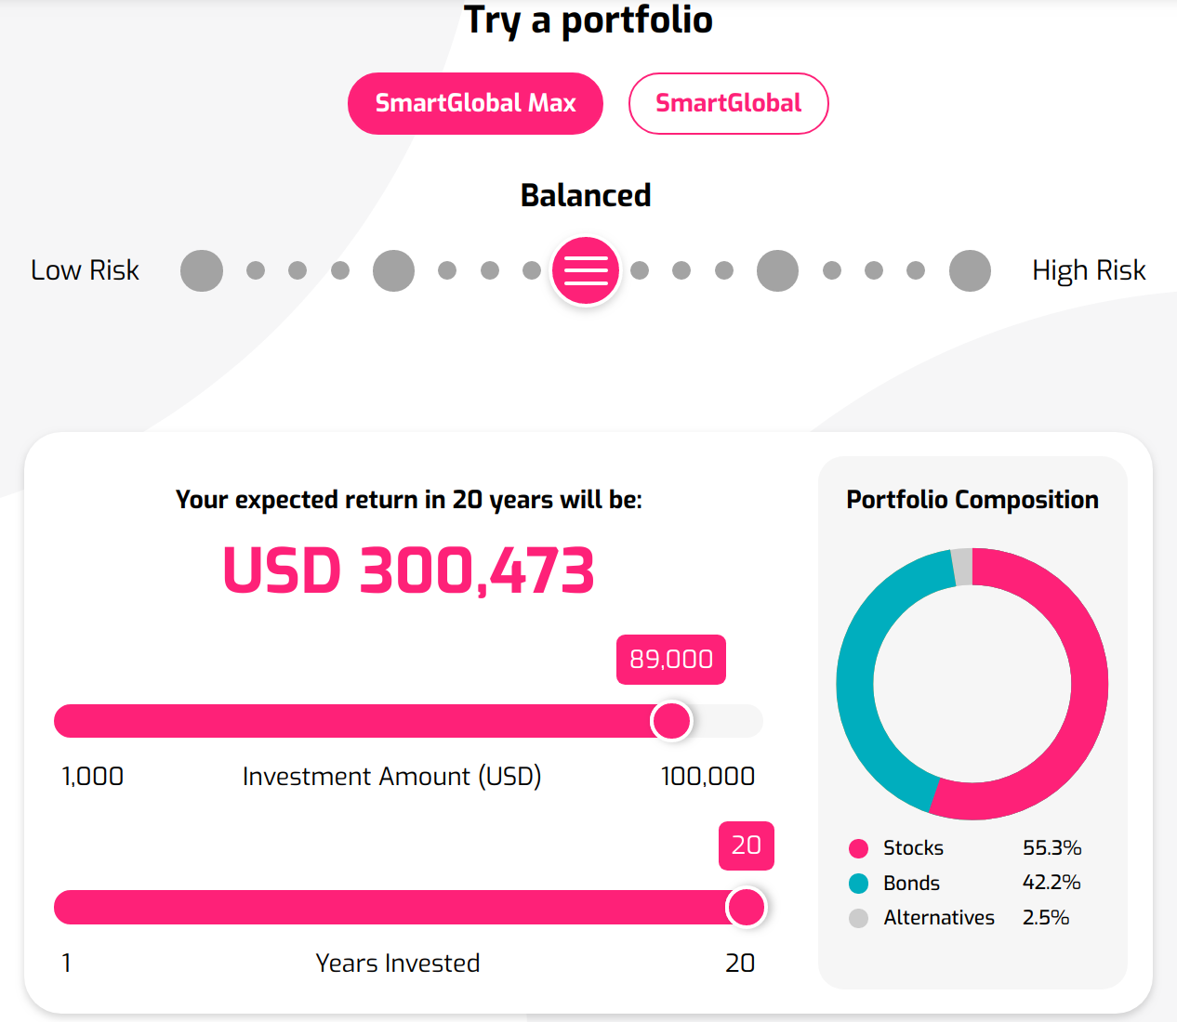
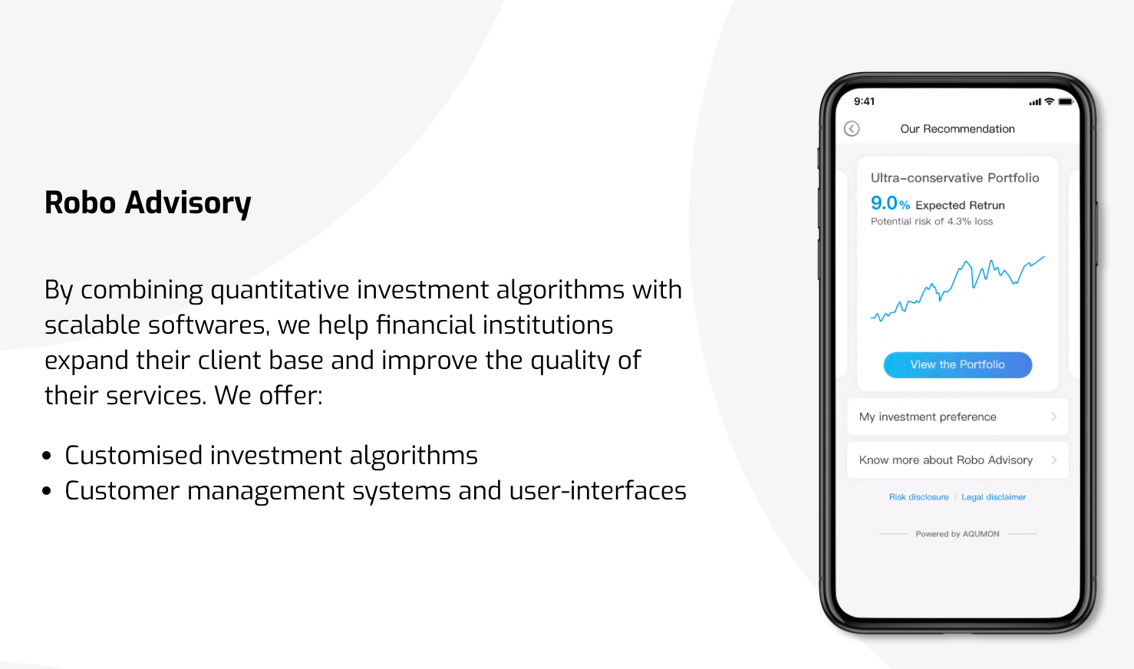
Some Pictures(去aqumon的官网找找素材)

Slide 7

Model Introduction

Slide 8
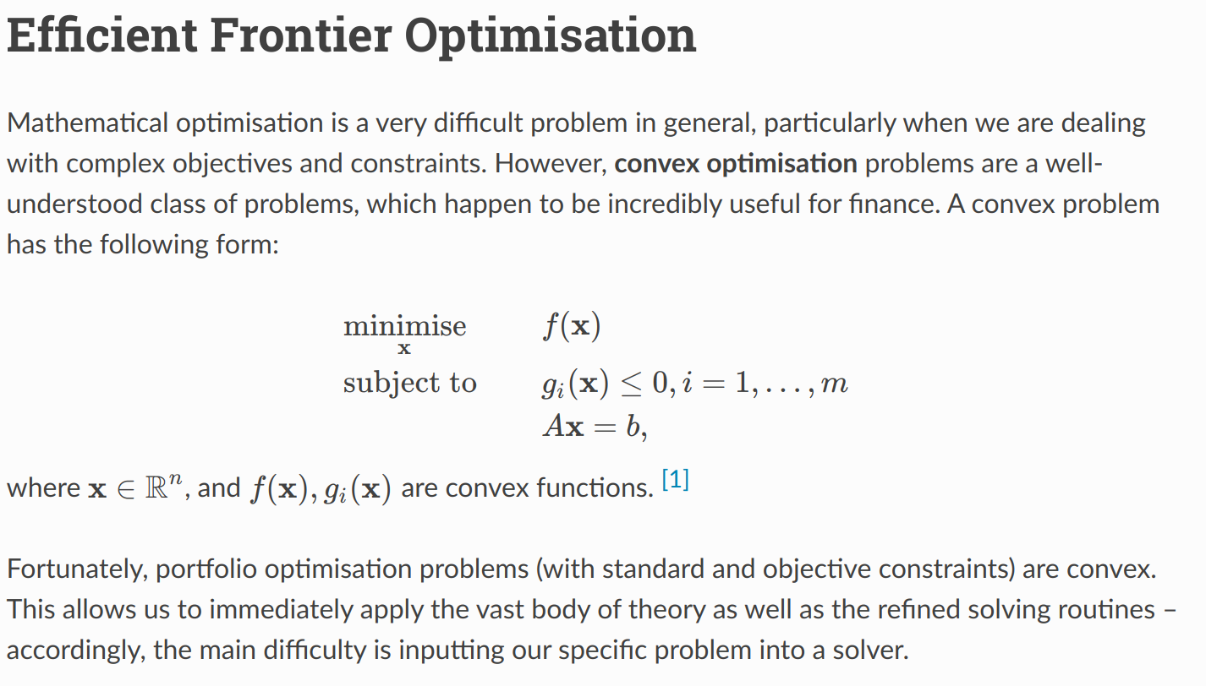
Markowitz Efficient Frontier

Slide 9
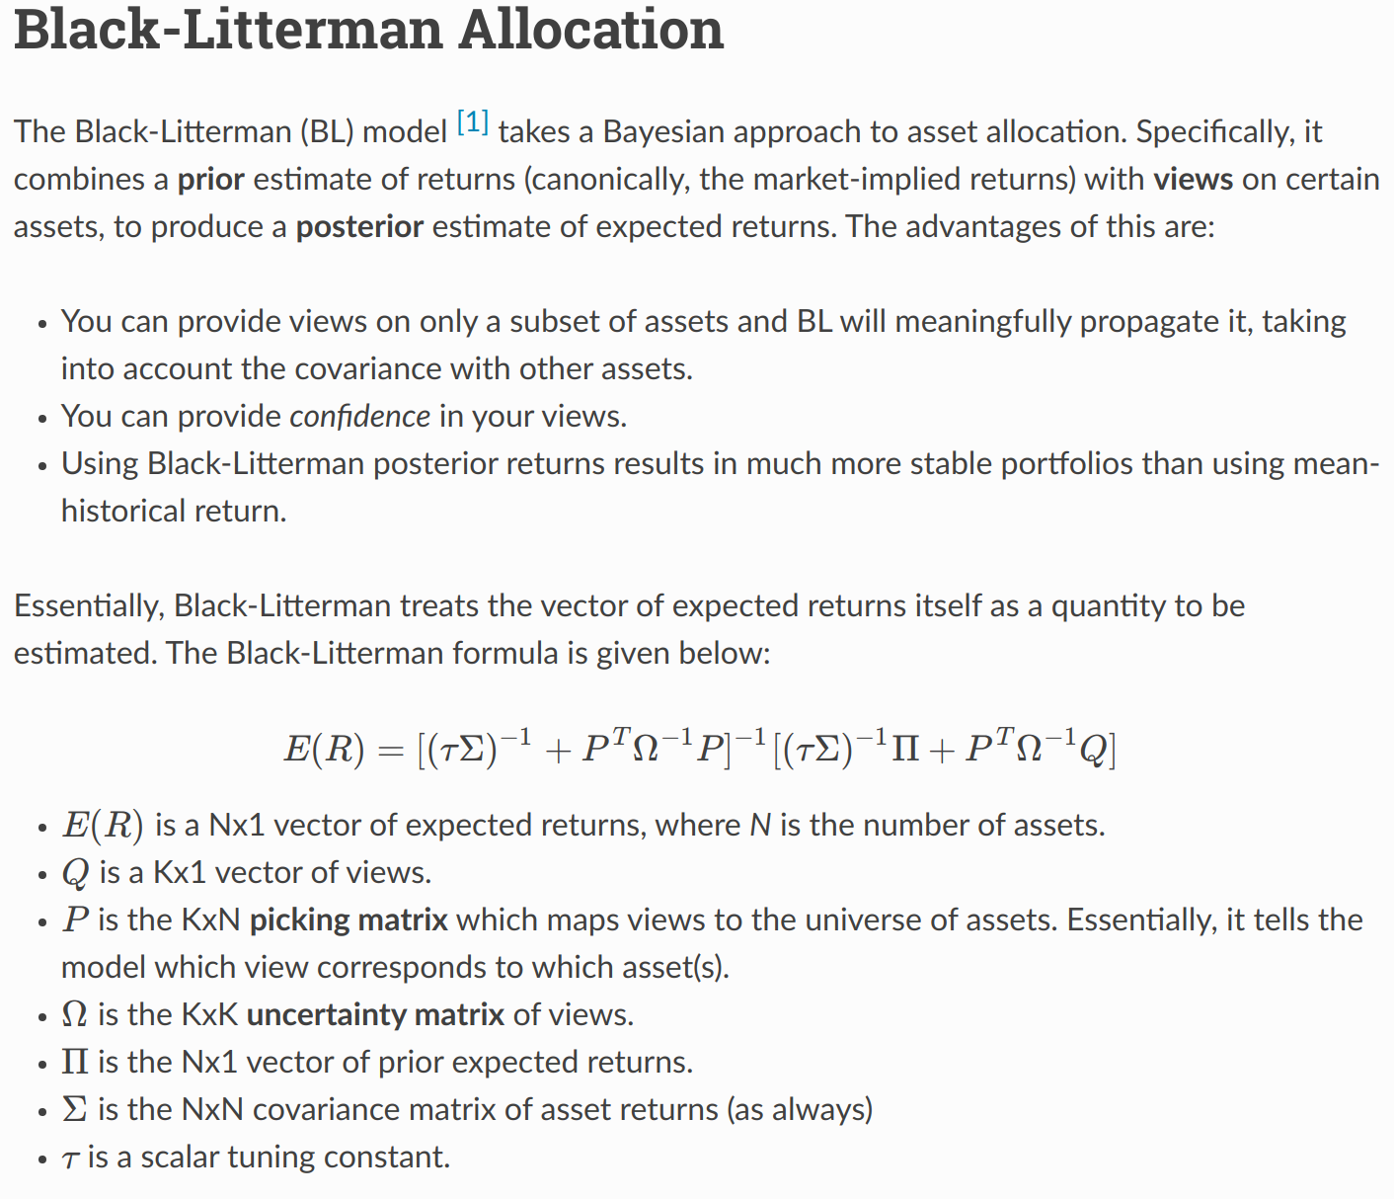
Black Litterman

Slide 10
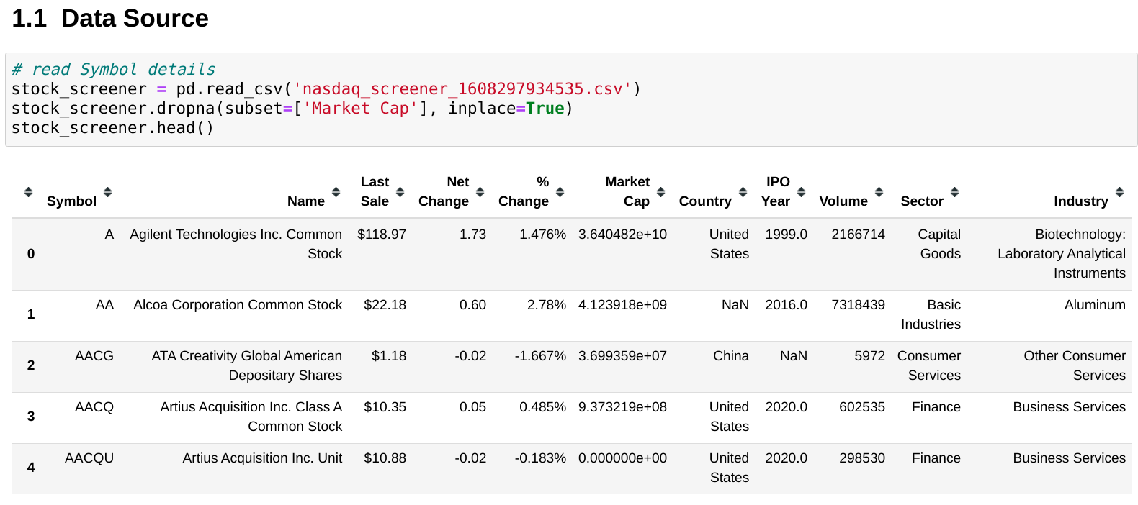
Implementation —— Take Top20 S&P 500 Symbols as Example

Slide 11
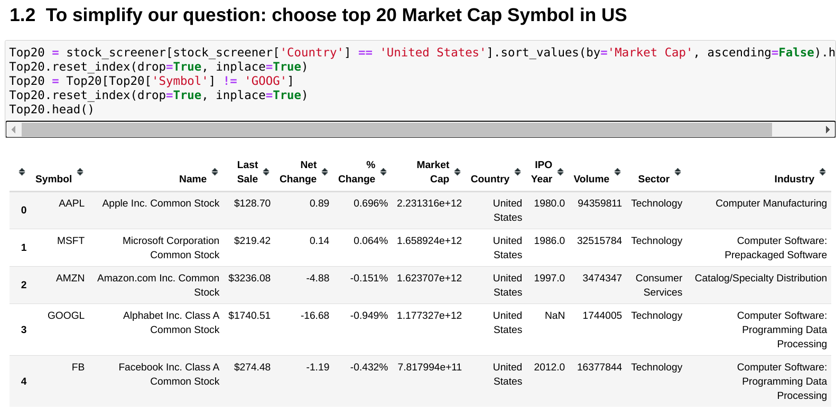
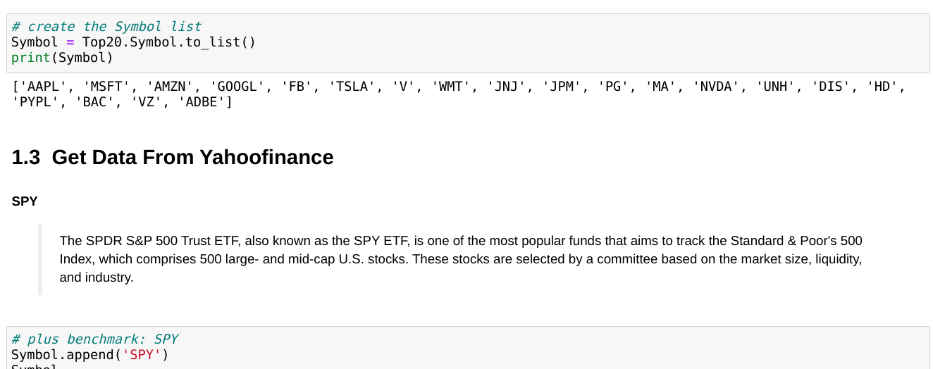
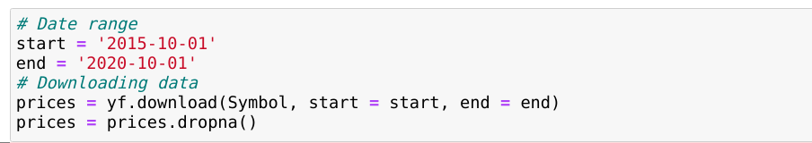
DATA INFO

Slide 12
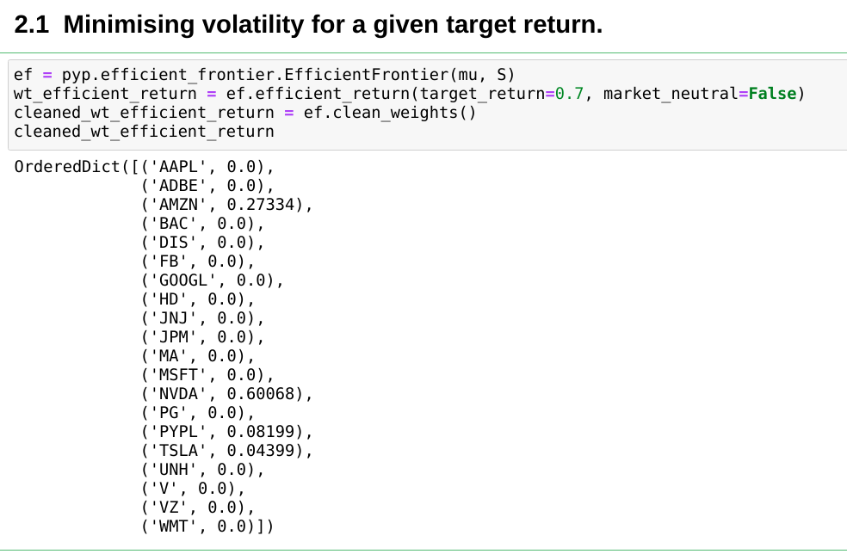
Efficient Frontier —— Minimising volatility for a given target return.

Slide 13
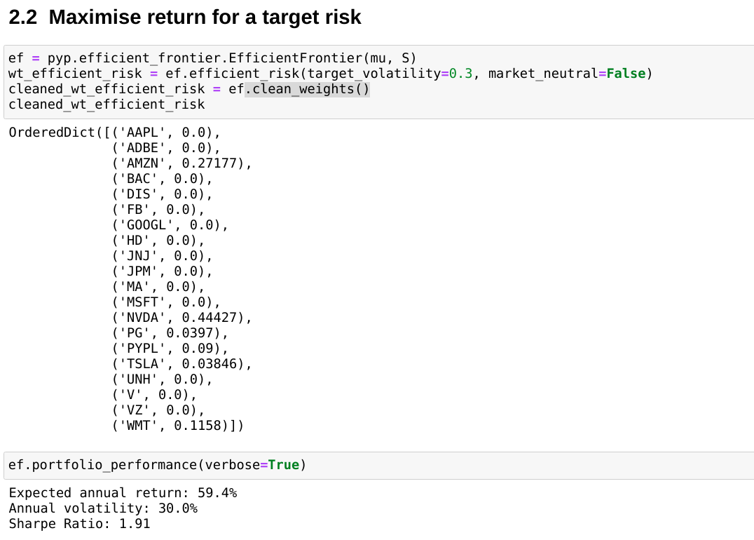
Efficient Frontier —— Maximizing return for a target risk

Slide 14
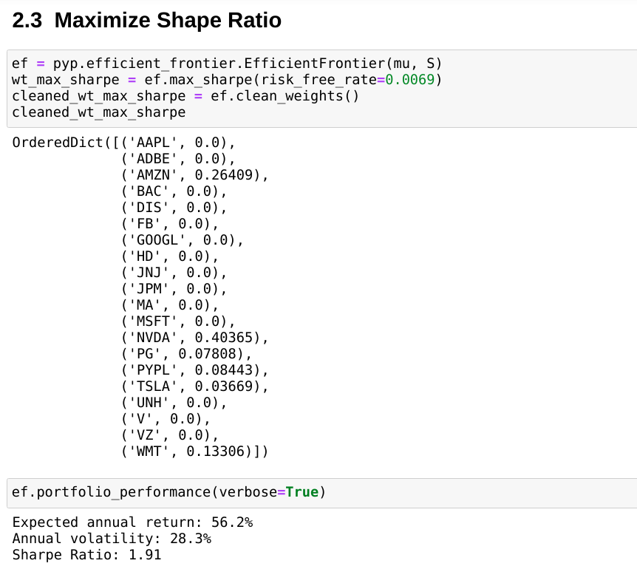
Efficient Frontier —— Maximize Shape Ratio

Slide 15
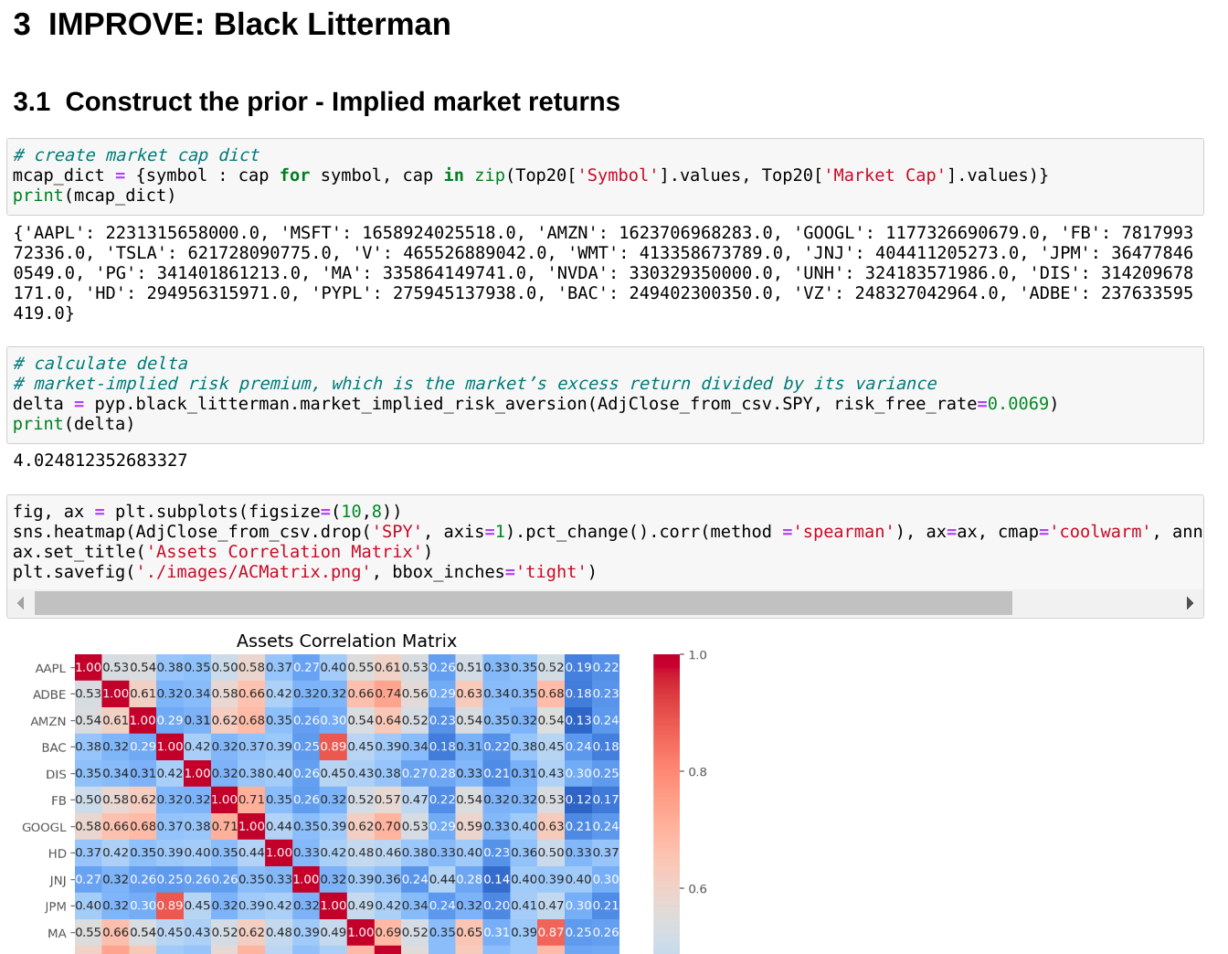
Combine with Black Litterman

Slide 16
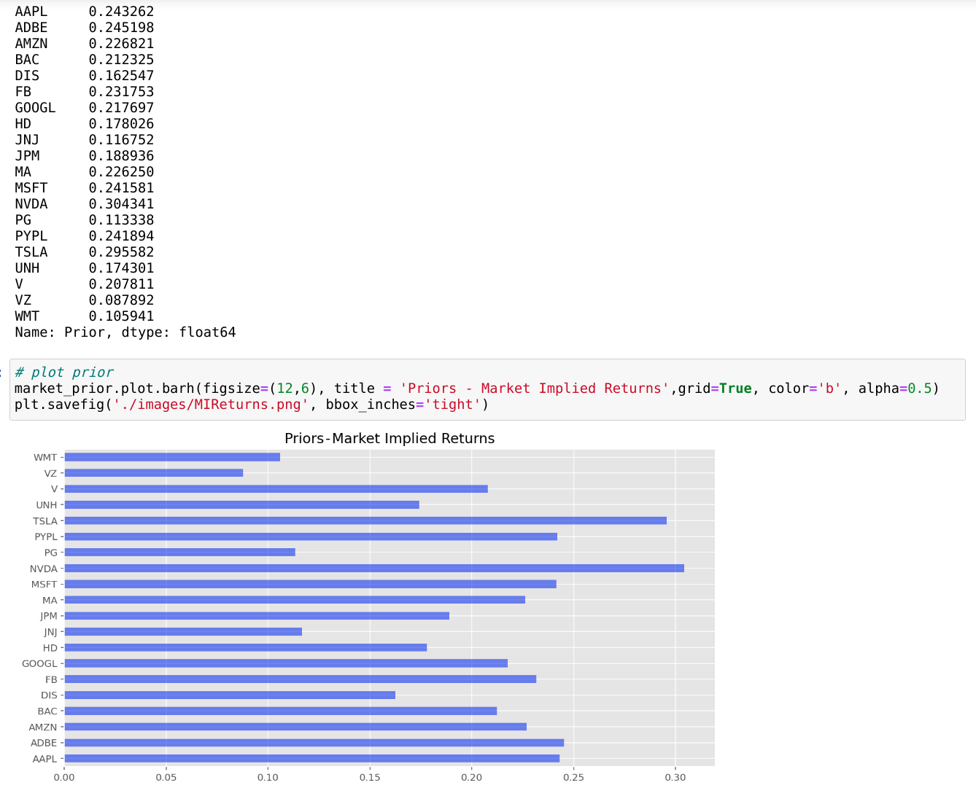
Construct Prior

Slide 17
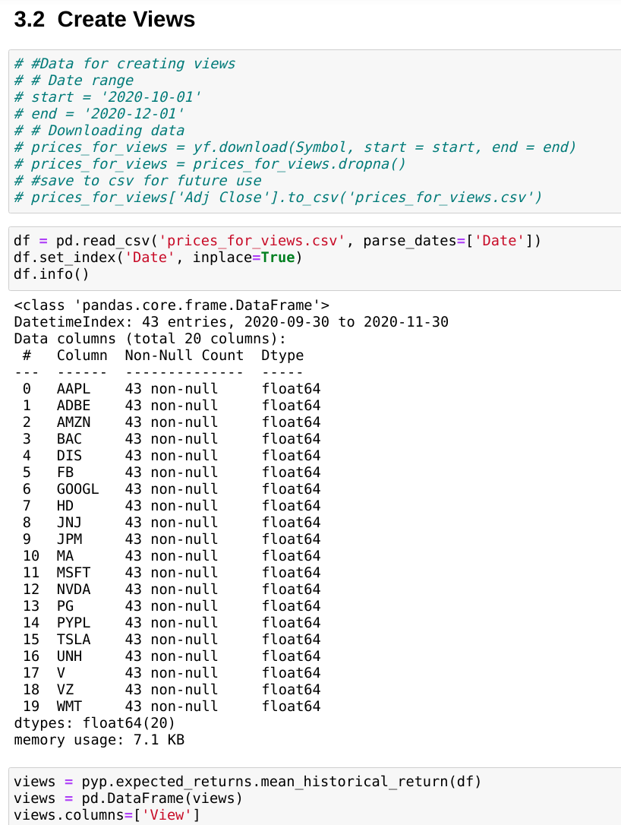
Create Views

Slide 18
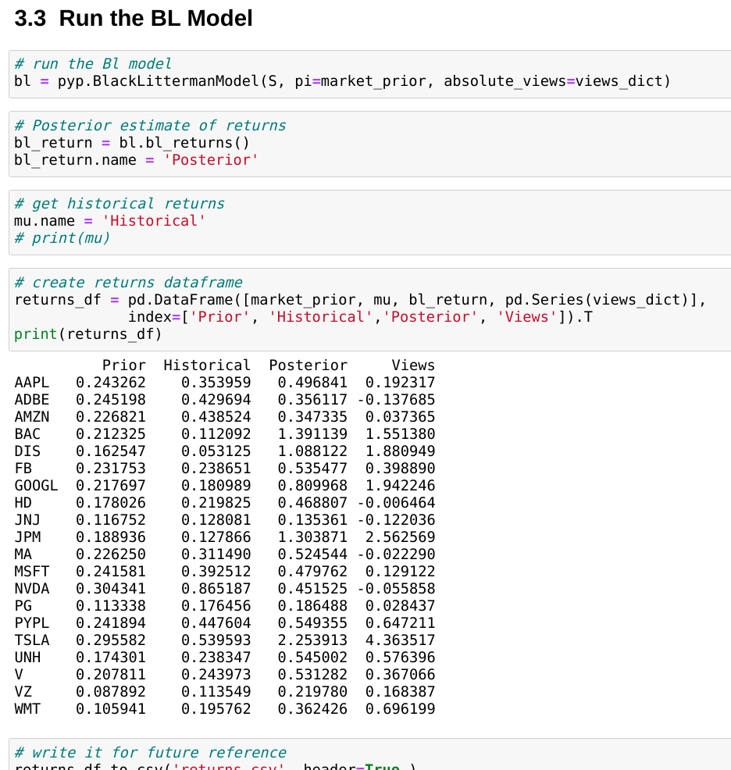

Slide 19
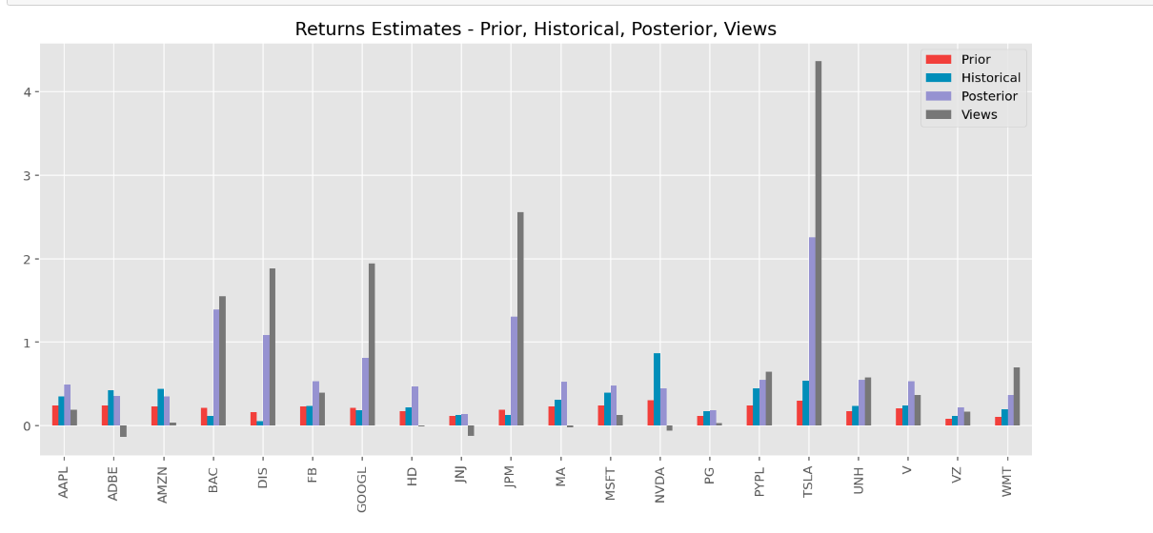

Slide 20
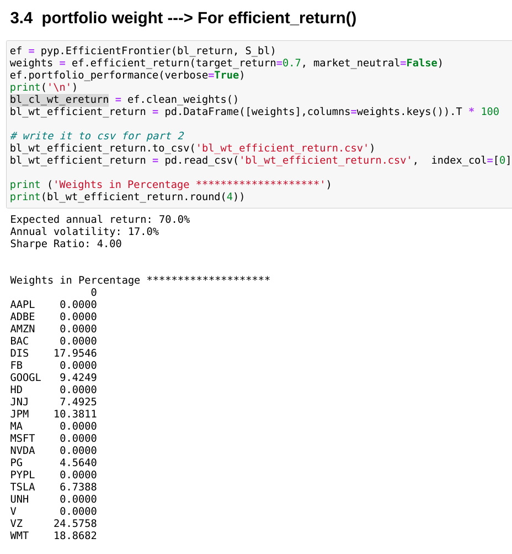
BL+efficient Return

Slide 21
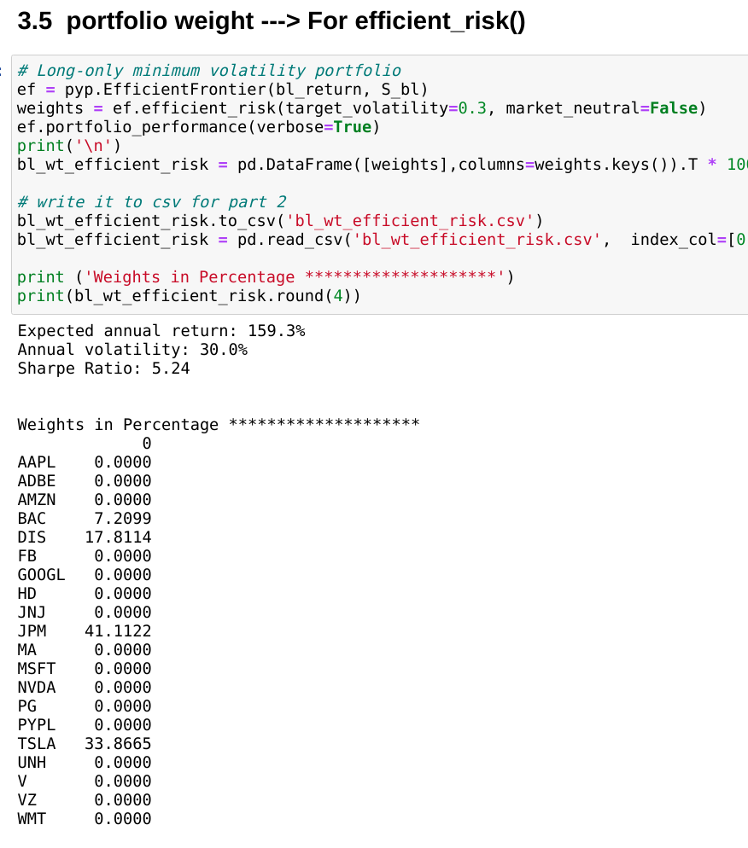
BL + Efficient Risk

Slide 22
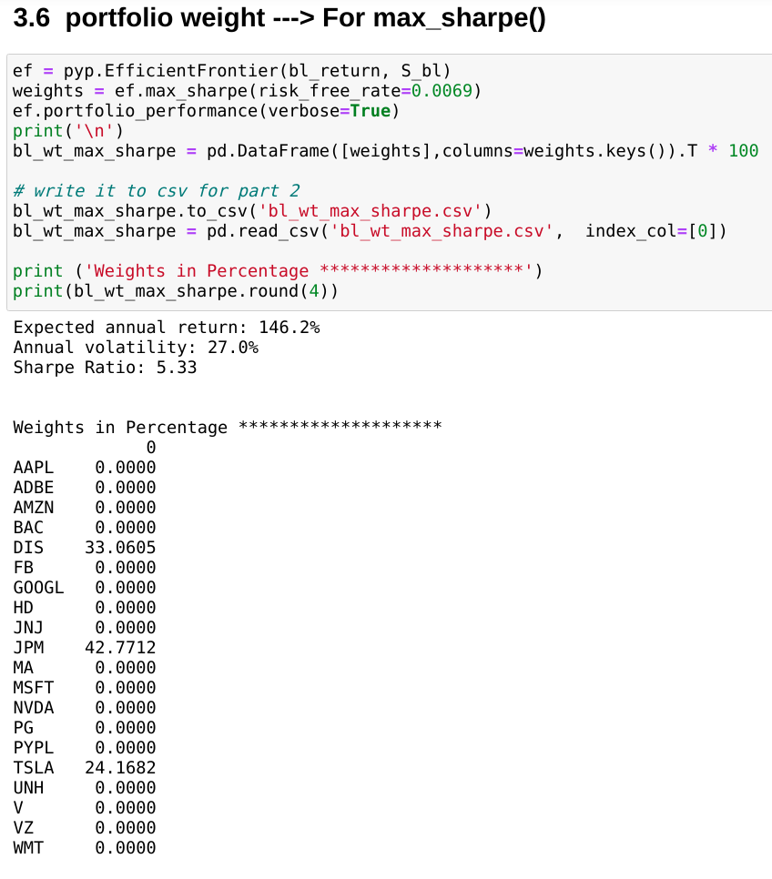
BL + Max Sharpe

Slide 23
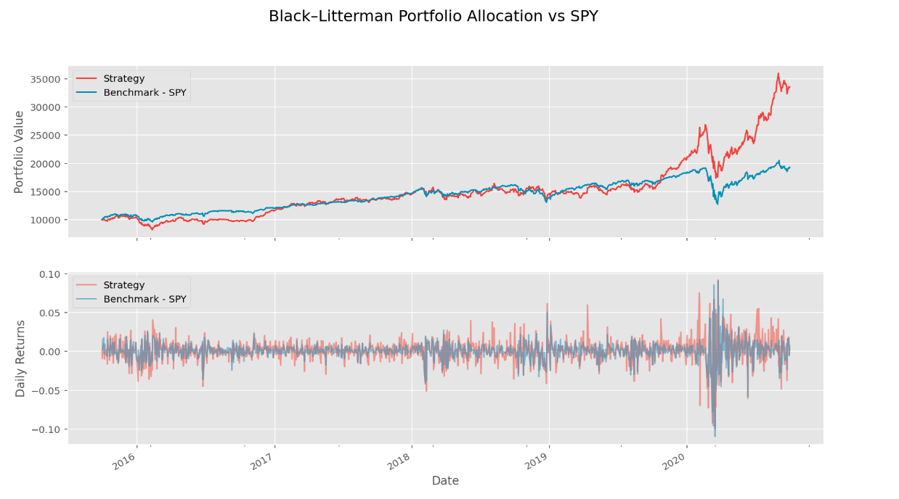
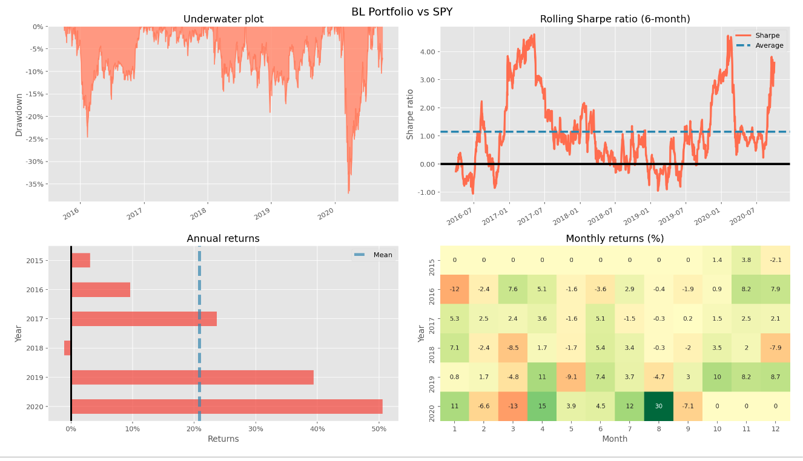
BackTesting —— Take BL+MaxSharpe for example

Slide 24
WebPage Display

